Slide 1
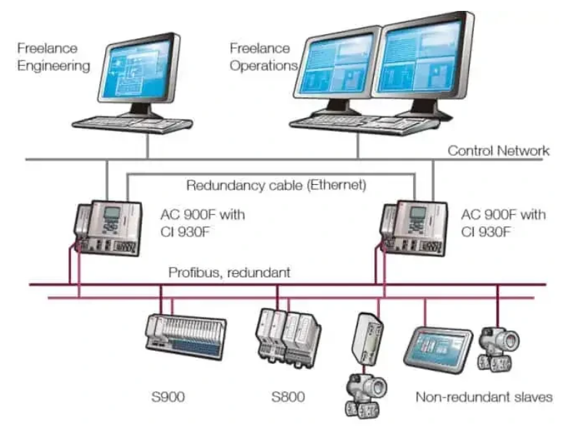
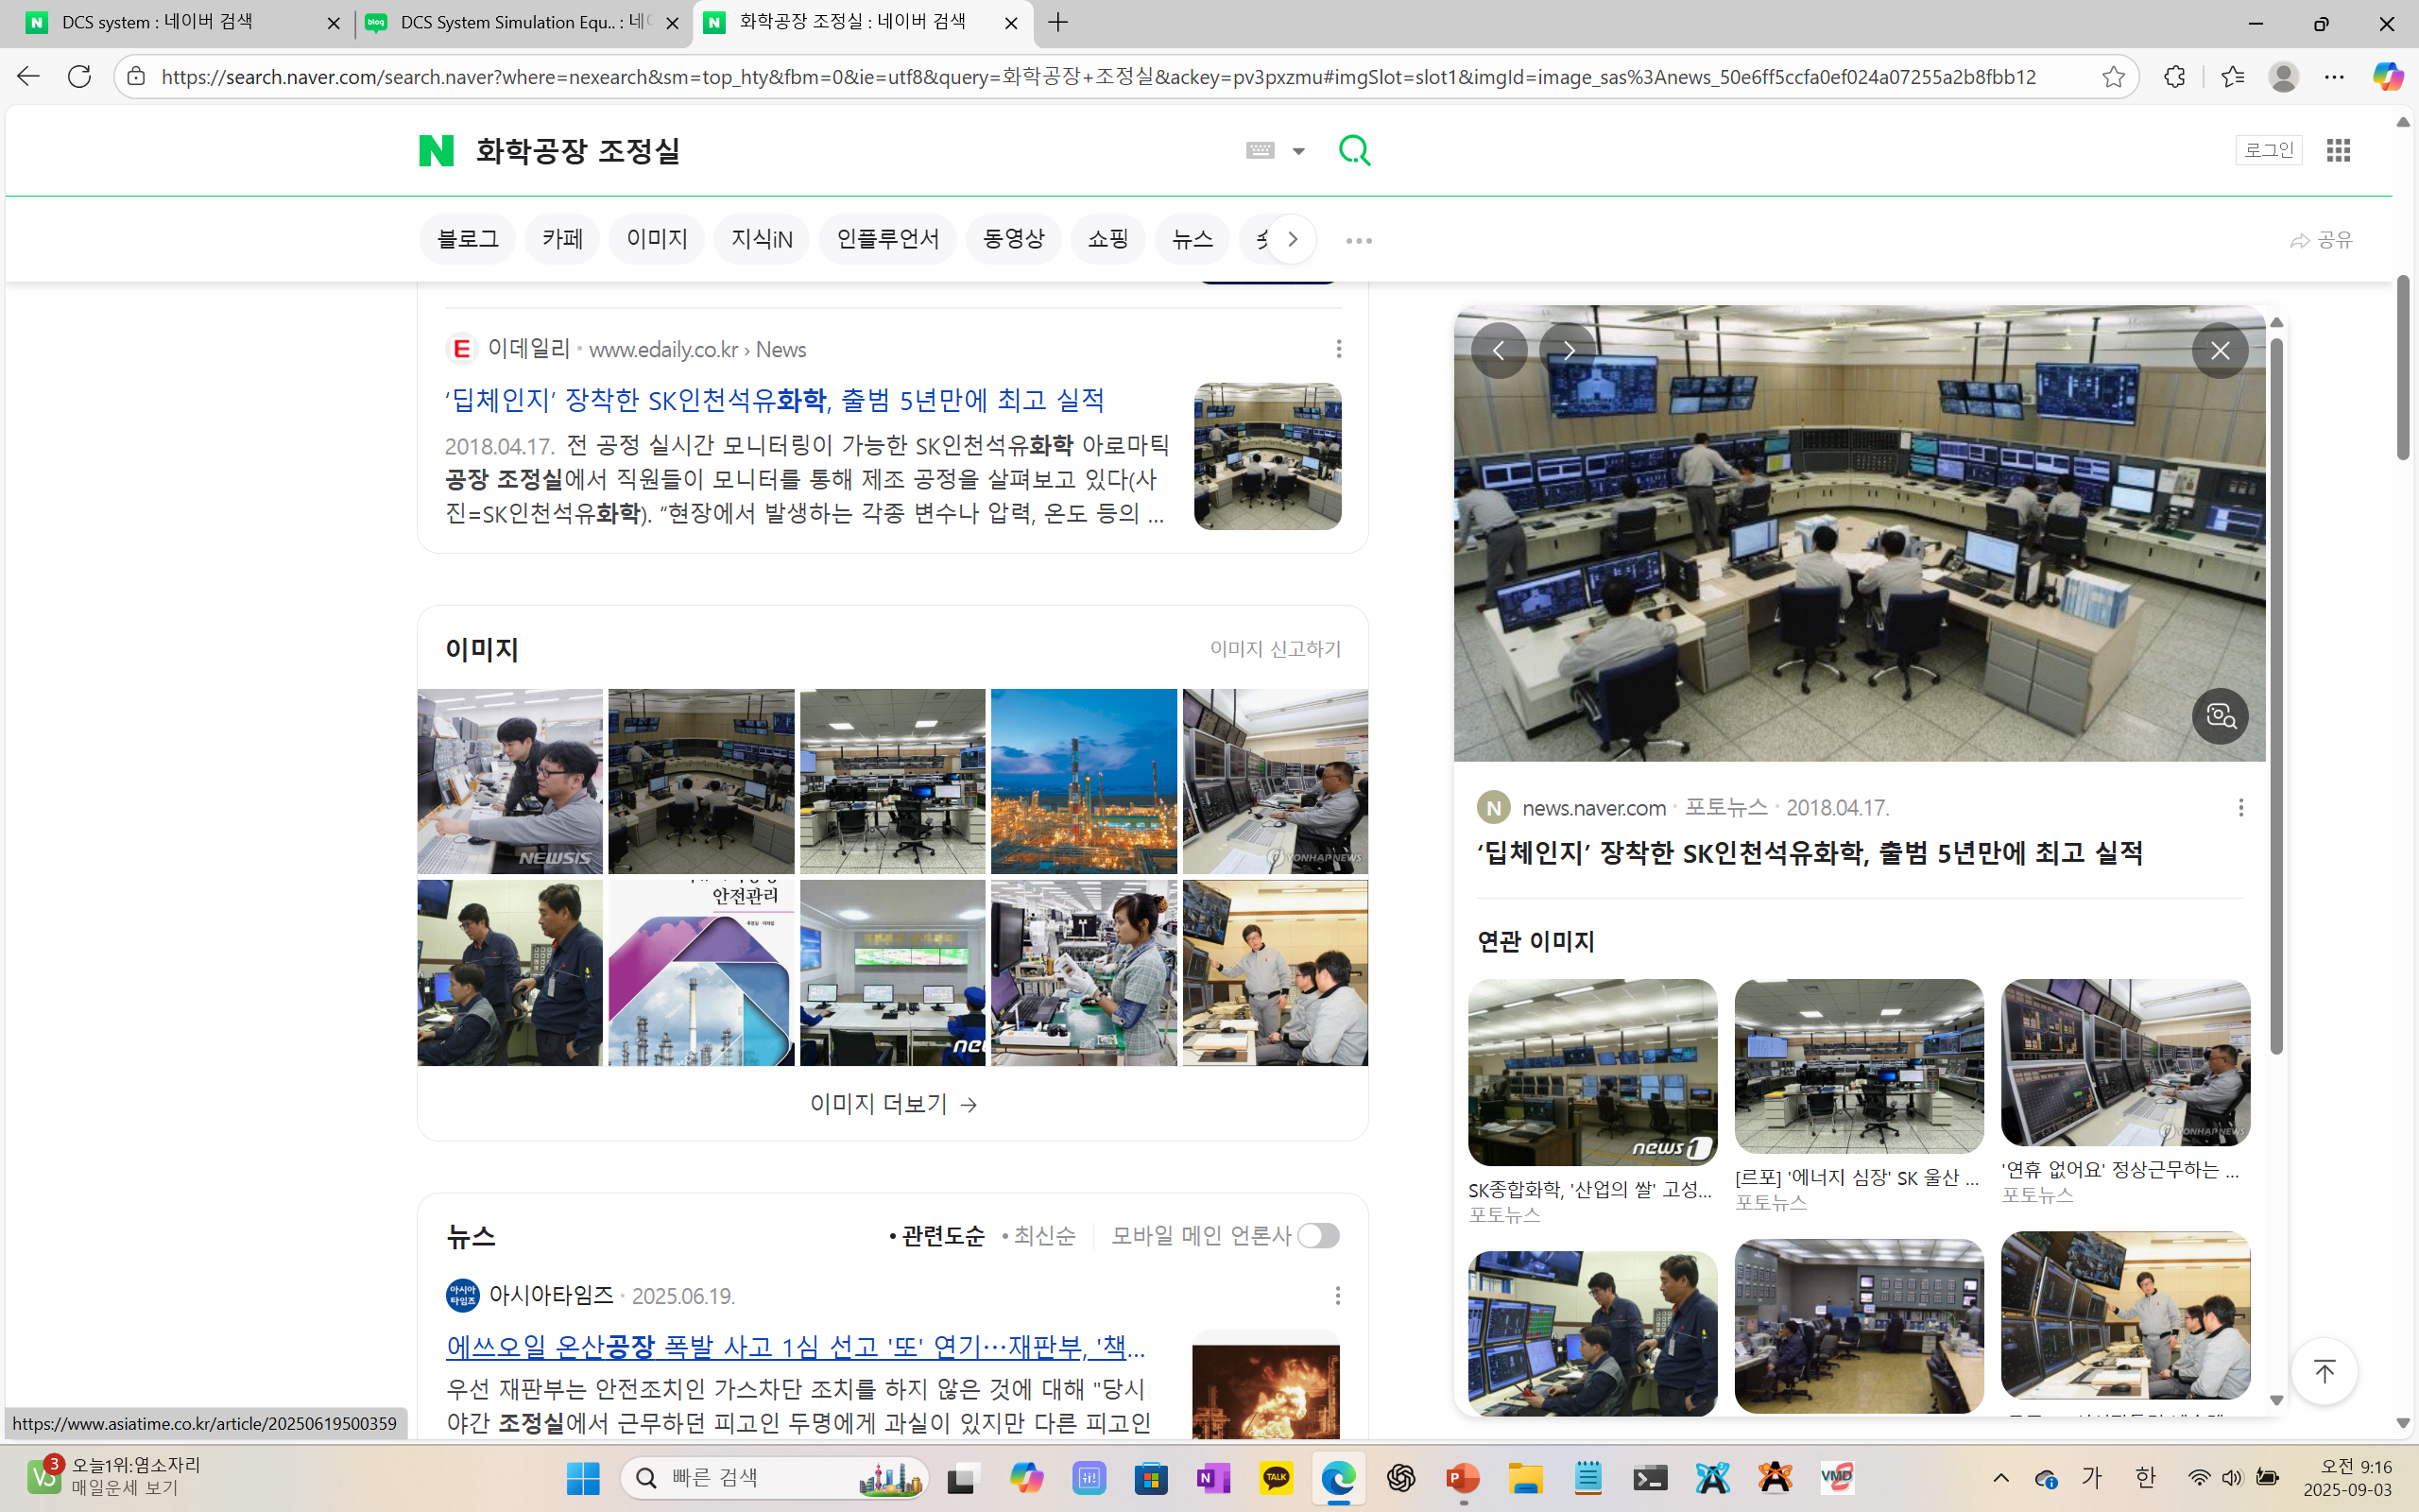
DCS(Distributed Control System, 분산제어시스템) - PID Controller

